Slide 1

Snapping Qt apps
Jesús Soto
KDE Akademy 2023, Thessaloniki GR

Slide 2




My experience with Qt
KDE Akademy 2023, Thessaloniki GR

Slide 3

Snapping strategies
From source
From a binary
From a .deb
In the end, it is just a container running Ubuntu LTS

Slide 4
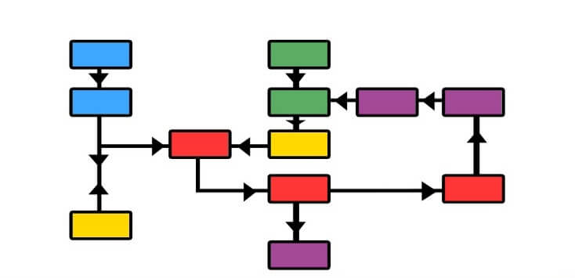
Stage your dependencies!
Keep an eye on your base (core##)
Regular runtime dependencies
debian/control
Lint warnings
ldd your executable
libQt5Xyz.so.5 => libqt5xyz5 (packages.ubuntu.com)

Slide 5
Remember your environment!
QT_PLUGIN_PATH
QML2_IMPORT_PATH
LD_LIBRARY_PATH (pulseaudio)
QTWEBENGINEPROCESS_PATH
Add an environment section with your variable definitions

Slide 6
Hardcoded paths & config files
Try to use environment variables if possible (QTWEBENGINEPROCESS_PATH)
Layout bindings (alsa, dri drivers, qt itself)
layout:
/usr/lib/$CRAFT_ARCH_TRIPLET/dri:
bind: $SNAP/usr/lib/$CRAFT_ARCH_TRIPLET/dri
/usr/share/alsa:
bind: $SNAP/usr/share/alsa
/usr/share/qt5:
bind: $SNAP/usr/share/qt5

Slide 7
Interfaces, plugs and permissions
Interfaces and plugs allow your snap to access resources outside of the sandbox.
Some examples include (not limited to):
Camera
Audio record/playback
Graphics acceleration
Network
https://snapcraft.io/docs/supported-interfaces
Some of them require to be connected manually (require approval for auto-connect)

Slide 8
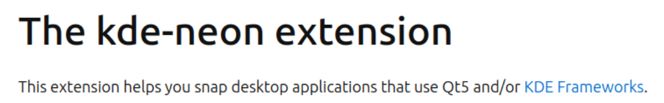
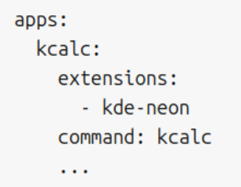
kde-neon extension
https://snapcraft.io/docs/kde-neon-extension

Slide 9


